Slide 1

Natural Language Processing with Disaster Tweets

Slide 2
1- Description for our projects
Twitter has become an important communication channel in times of emergency.
The ubiquitousness of smartphones enables people to announce an emergency they’re observing in real-time. Because of this, more agencies are interested in programatically monitoring Twitter (i.e. disaster relief organizations and news agencies).
But, it’s not always clear whether a person’s words are actually announcing a disaster. so in this project we will work how we can detect or know if they are emergency by tweets

Slide 3
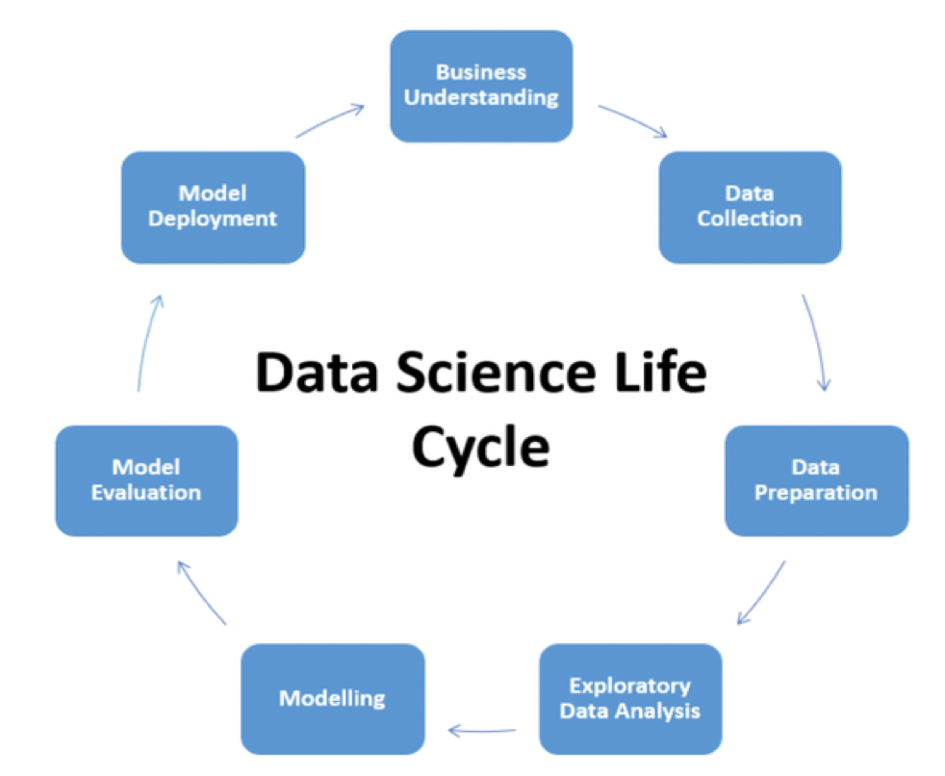
2- steps for project

Slide 4
3-Data Preparation
Cleaning up the text data is necessary to highlight attributes that we are going to want our model to pick up on. Cleaning (or pre-processing) the data typically consists of number of steps:
Removing punctuation
Converting text to lowercase
Tokenization
Removing stop-word
Stemming
We use the function wrangle for do that .

Slide 5
4-Vectorization
We use two type for see the best one :
CountVectorizer operates by tokenizing the text data and counting the occurrences of each token. It then creates a matrix where the rows represent the documents, and the columns represent the tokens. The cell values indicate the frequency of each token in each document.
TF-IDF vectorization involves calculating the TF-IDF score for every word in your corpus relative to that document and then putting that information into a vector

Slide 6
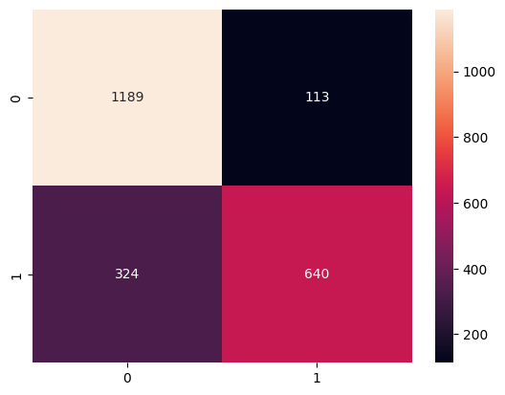
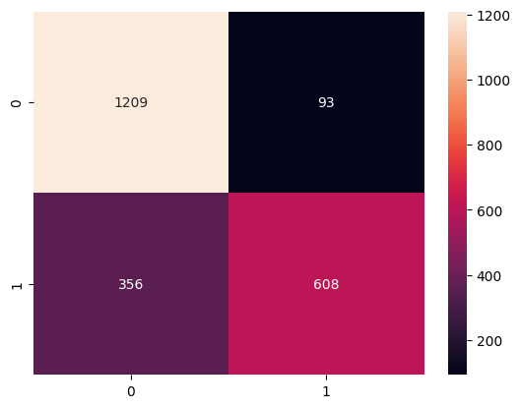
5-SVM
CountVectorizer
TF-IDF

Slide 7
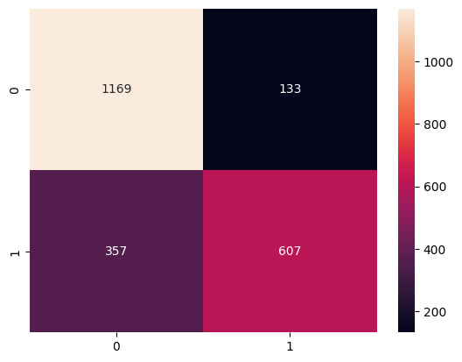

6-RandomForest
CountVectorizer
TF-IDF

Slide 8


7-LogisticRegression
CountVectorizer
TF-IDF

Slide 9
8-Summary
The best model we see here is model SVC with vectorization TF-IDF and also the the test in competition is 0.795

